Slide 1
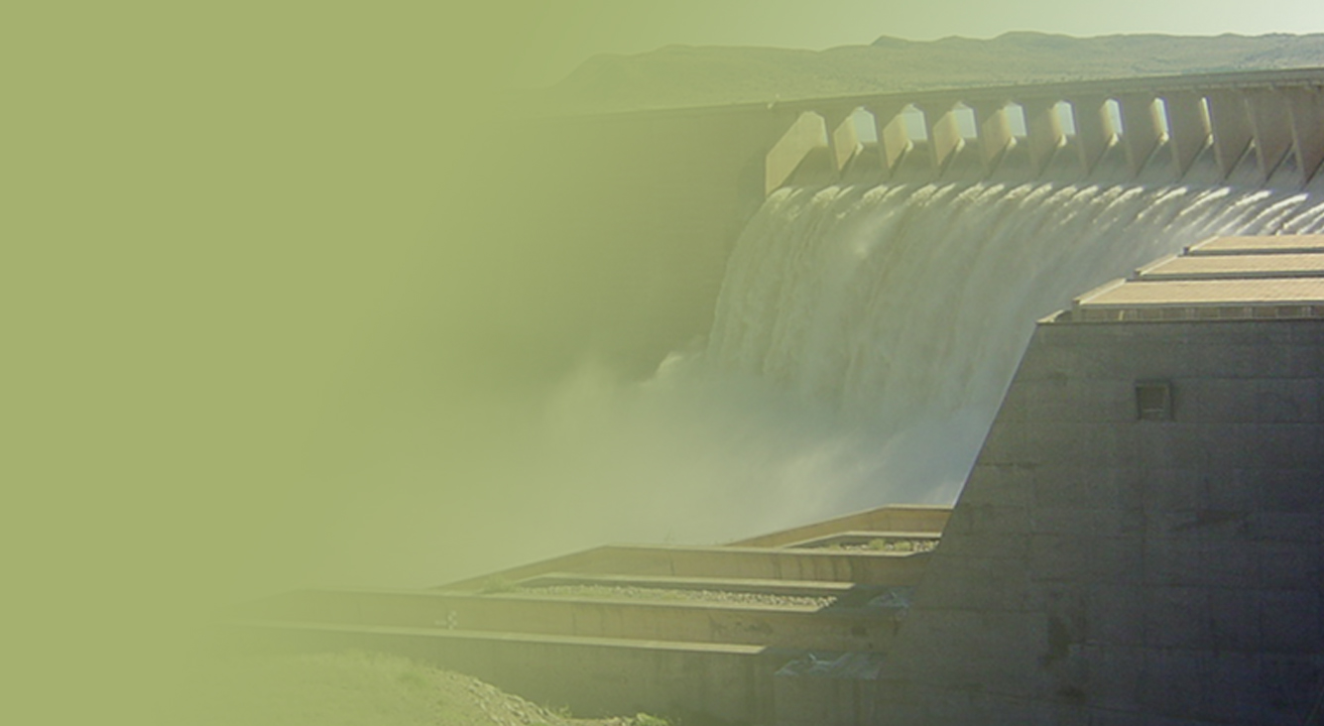
ALGOA
WATER SUPPLY SYSTEM
2018-2019 AOA
15 August 2018
PRESENTATION TITLE
Presented by:
Name Surname
Directorate
Date
Prepared by Jenny Pashkin

Slide 2
Current operating strategy

Slide 3
NMBM WATER USE (1 of 3)
System Operating Forum for 2018-2019 cycle was held on 14 June 2018;
Overall 30% restrictions agreed to be imposed on the NMBM from 1 June 2018;
Restrictions are in terms of the estimated unrestricted projected consumption of 123.36 million m³/a (330 Ml/day) for the Metro, which equals to the restricted projected consumption of 86 million m³/a (230 Ml/day);
NMBM can only abstract a raw water volume of 35.9 million m³/a (97 Ml/d) from the Kromme, Kouga and Groendal sub-systems (local resources);

Slide 4
NMBM WATER USE (2 of 3)
NMBM abstraction volumes | Gross water allocation million m³/a (Ml/d) | Restricted water allocation million m³/a (Ml/d) | % restr per sub-system
Kromme Sub – system | 38.08 (102.82) | 18.6 (50.2) | 46
Kouga Sub – system | 23 (62.1) | 7.9 (21.2) | 68
Groendal Sub – system | 6.8 (18.4) | 6.1 (16.5) | 15
Old dams Sub – system | 3.3 (9) | 3.3 (9) | 0
Total | 67.9 (183.28) | 35.9 (96.9)

Slide 5
NMBM WATER USE (3 of 3)
To make up the deficit in the amount of water needed within the Metro a minimum of 50 million m³/a (135 Mℓ/d) should be supplied to the NMBM from the Sundays River sub-system to reach a total net supply of 86 million m³/a (230 Ml/day)

Slide 6
AGRICULTURAL WATER USE RESTRICTIONS Gamtoos Irrigation Board (GIB) Water Use
GIB allocation million m³/a | % restrictions | Restricted abstraction volumes million m³/a
60.3 | 80 | 12.06
80% restrictions imposed on the Gamtoos Irrigation
Board (GIB) are in terms of the existing lawful
allocation 60.3 million m³/a;
The GIB is allowed a TOTAL abstraction of 16.6 million m³/a. This includes losses of ± 4.5 million m³/a. If the losses is going to be as high as 2017/2018 (7 million m³/a) the actual use should reduce to 9.6 million m³/a.

Slide 7
State of storage

Slide 8
STORAGE LEVELS
 | Nett Full | Storage | Storage | Current storage | Current storage
Dam | Supply |  |  | % full | volume
 |  | % full | Levels (% full)
 | Capacity (million m³) |  |  | 30 July 2018 (week 31) | (million m³)
 |  | same time last year | on 1 June 2018 (decision date)
Churchill | 35.24 | 7.8 | 16.9 | 15.9 | 5.6
Impofu | 105.76 |  |  | 29.5 | 31.2
 |  | 58.3 | 32.9
Kouga | 125.91 |  |  | 7.0 | 8.8
 |  | 15.3 | 8.3
Loerie | 3.03 |  |  | 68.3 | 2.1
 |  | 27.5 | 82.9
Groendal | 11.64 |  |  | 39.2 | 4.6
 |  | 49.2 | 43.8
Total system | 281.6 | 32.0 | 21.8 | 18.5 | 52.1

Slide 9
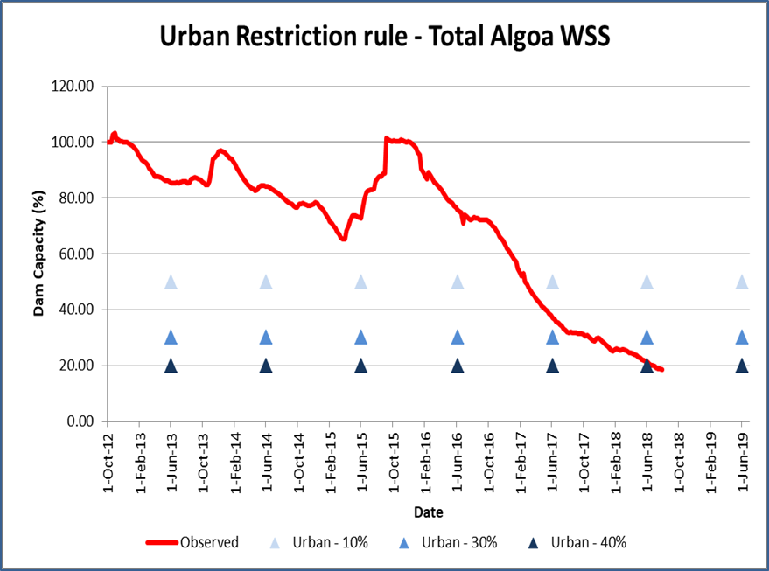
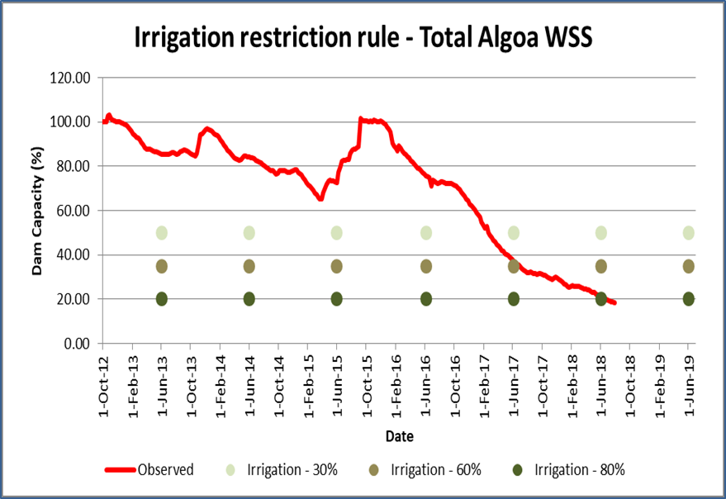
Total Algoa System
long-term
monitoring

Slide 10
WAY FORWARD

Slide 11
DROUGHT MITIGATION ACTIVITIES
Algoa Water Supply System performance monitoring;
Actual water use monitoring;
Monthly restrictions monitoring committee meetings scheduled for the rest of the year. Encourage attendance of all stakeholders;
Compliance to the restricted water use volumes is critical;
Fast-tracking of the ground water resources development and monitoring of the aquifers is critical.

Slide 12
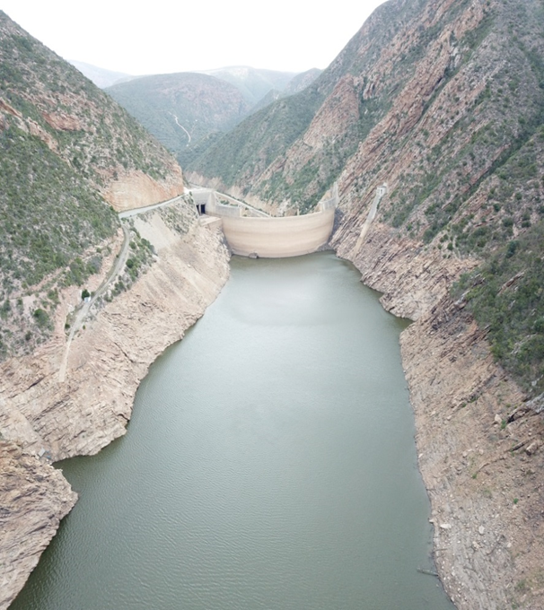
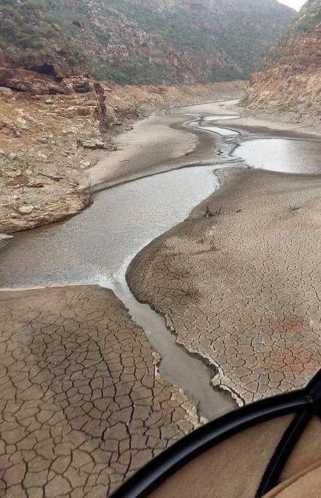
THANK YOU

